Slide 1
Project Meeting
July 6th 2016

Slide 2
OCR Test 2015 vs 2016 (with italics)
29 pages
Mix of what I showed last week
Margin Text
Page bend
Ink Bleed through
4 pages from Conversations
2 Italic
2 Regular
Show OCR output before post-processing

Slide 3
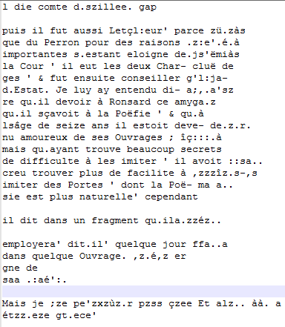
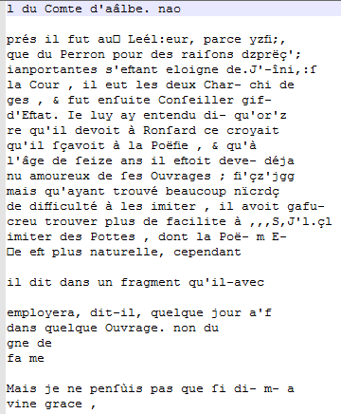
Full-Page Margin Text
OCR 2015
ImageMagick TIFF
Italic Training OCR

Slide 4
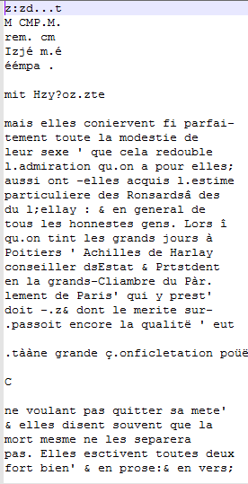
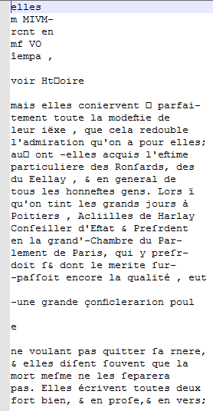
Short Margin Text
OCR 2015
ImageMagick TIFF
Italic Training OCR

Slide 5
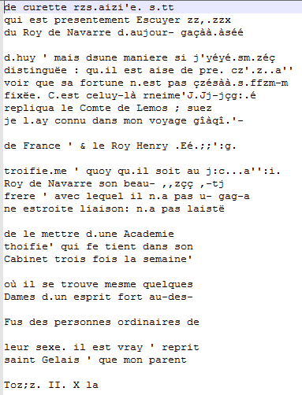
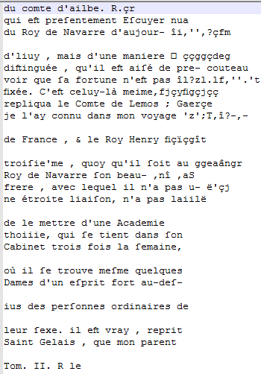
Half-Page Margin Text
OCR 2015
ImageMagick TIFF
Italic Training OCR

Slide 6
Short Margin Text
OCR 2015
ImageMagick TIFF
Italic Training OCR

Slide 7
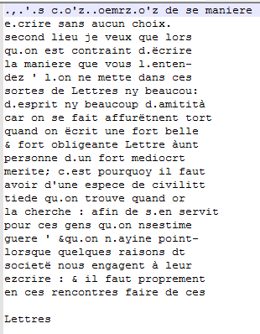
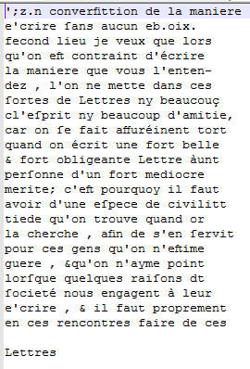
Page Bend
OCR 2015
ImageMagick TIFF
Italic Training OCR

Slide 8
Minor Ink bleed-through
Original TIFF
ImageMagick TIFF

Slide 9
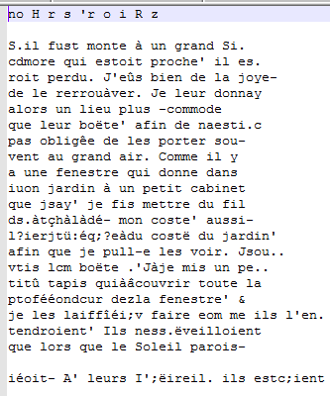
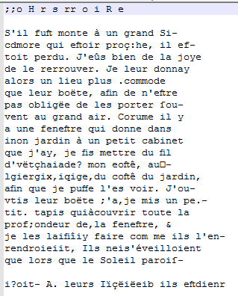
Minor Ink bleed-through
OCR 2015
ImageMagick TIFF
Italic Training OCR

Slide 10
Major Ink Bleed-through
Original TIFF
ImageMagick TIFF

Slide 11
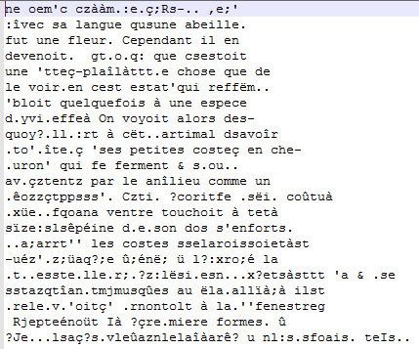
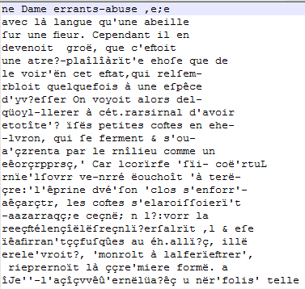
Major Ink bleed-through
OCR 2015
ImageMagick TIFF
Italic Training OCR

Slide 12
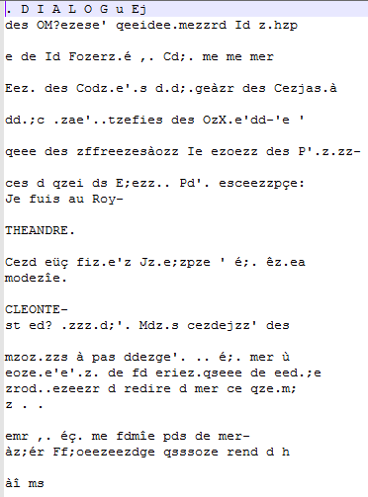
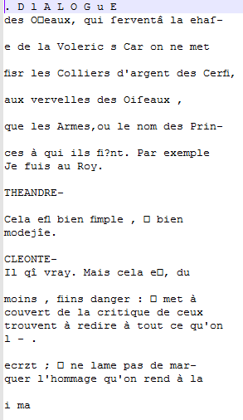
Conversations - Italics 1
OCR 2015
ImageMagick TIFF
Italic Training OCR

Slide 13
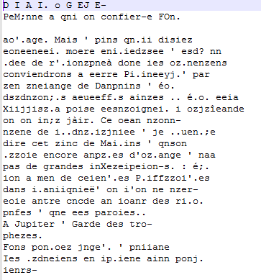
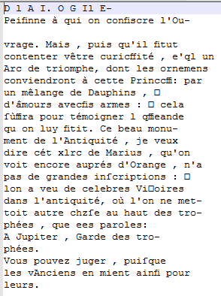
Conversations - Italics 2
OCR 2015
ImageMagick TIFF
Italic Training OCR

Slide 14
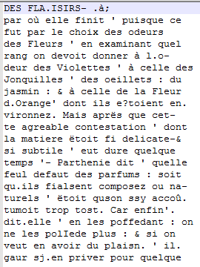

Conversations - Regular 1
OCR 2015
ImageMagick TIFF
Italic Training OCR

Slide 15
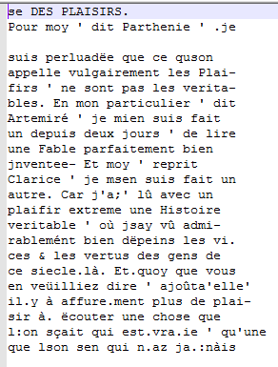
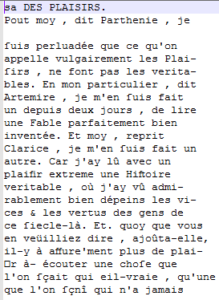
Conversations - Regular 2
OCR 2015
ImageMagick TIFF
Italic Training OCR

